Slide 1


The Genotype Ontology
An OWL Model for the Integration and Analysis of G2P Data
Matthew Brush
The Monarch Initiative
https://monarchinitiative.org/
Ontology PURL: http://purl.obolibrary.org/obo/geno.owl

Slide 2
Challenges/Approaches
Challenges
Each MOD has a different data model for genotypes and genetic entities
Each MOD has different curation practices for which kind of entity they attach to phenotypes
Approach
Hierarchical ‘partonomy’ model of genotypes
Analogy with genomic entities
Gene, transcript, feature
GFF3, SO
GENO: Genotype Ontology
https://github.com/monarch-initiative/GENO-ontology

Slide 3
GENO Overview
Coverage
Genotypes and their component elements of genetic variation as found across human and model organism databases
describes features variant in their sequence (‘intrinsic’ variation) and features variant in their expression (‘extrinsic’ variation)
Attributes of these variant features
e.g. zygosity, genomic position, copy number, etc.
Experimental tools and reagents used to generate such variant features
e.g. constructs, RNA interference reagents, Crisprs/TALENs
G2P ‘Association’ patterns to describe causal relationships to phenotypes and diseases
. . . as qualified by environment and developmental stage
. . . as supported by evidence and provenance metadata

Slide 4
GENO Overview
Ontological Foundations
BFO upper ontology, follows OBO Foundry principles.
Orthogonal to and interoperable with the Sequence Ontology
extends SO with a more extensive/principled account of genetic variation
Re-uses terms and patterns from SO and other ontologies:
FALDO (genomic position descriptions)
OBAN (G2P association model)
SEPIO (evidence/provenance model)
Development
Openly developed on Github (link) under Monarch Initiative organization, driven largely by Monarch data and use cases
Currently being prepared for first public release and publication

Slide 5
GENO Overview
Use Cases
Data Integration: Unified semantic representation of G2P data from diverse sources and species
where phenotypes annotated to different ‘levels’ of variation
Data Operation: logical foundation for analysis and inference
e.g. propagation of phenotypes across levels of genotype granularity
Data Annotation: provide terms for annotation of curated variant data
e.g. MOD datasets
e.g. DAF and PAF formats

Slide 6
The (Intrinsic) Genotype Partonomy
An ‘intrinsic’ genotype is decomposed into its more fundamental components of variation that represent the ‘levels’ of a genotype at which phenotype associations are commonly made.
AACGTAGCGACGCTCGCTACGGGCGTATC
AACGTAGCGACGCTCGCTACGGGCGTATC
CGTAGC
X
=
X
(complete genome)
AACGTACCGACGCTCGCTACGGGCGTATC
AACGTACCGACGCTCGCTACGGGCGTATC
+
CGTACC
X
X
ACAC
GCGAAGTGCCAACTTCTACACACACAAAG
GCGAAGTGCCAACTTCTACACACACAAAG
X
X
ACAC
GCGAAGTGCCAACTTCTACACACACAAAG
GCGAAGTGCCAACTTCTACACACACAAAG
genotype
background genotype
genomic variation
complement
fgf8a^{ti282a/ti282a}; fgf3^{t24149/+} (AB)
(AB)
fgf8a^{ti282a/ti282a}; fgf3^{t24149/+}
X
genomic variation
complement (GVC)
X
X
fgf8a^{ti282a/ti282a}; fgf3^{t24149/+}
*
has_part
has_part
X
variant single locus
complement (VSLC)
fgf8a^{ti282a/ti282a}
X
has_part
has_part
allele
(haplotype)
fgf8a^{ti282a}
X
has_part
has_part
X
sequence alteration
ti282a
* Note that breakdown of only fgf8a is shown here, but the fgf3 locus variation is similarly decomposed using the GENO model
Notes:
The core of GENO is a partonomy that “decomposes” a complete intrinsic genotype into its smaller components.
Intrinsic genotypes are what biologists traditionally think of as specifying the total genomic changes across an entire genome sequence - in terms of variation from some reference genome.
This figure shows a GENO representation of a zebrafish genotype containing two altered loci – a heterozygous point mutation in the apc gene (hu745), and a homozygous point mutation in the shha gene (ti282a). GENO classes are shown in blue along with a schematic of the genomic sequence they specify. An example instance of each class from a zebrafish genotype are show in green.
The top level breakdown decomposes a complete genotype into a background genotype, which describes a characterized reference/background genome, and a genomic variation complement, which represents the allelic composition of each variant in the genome. This genotype contains a heterozygous mutation at the apc gene, and homozygous mutation of the fgf8a gene.
The second part of this figure shows how GENO further decomposes this genomic variation complement (shown here only for the fgf8a variant, but the apc variant would be similarly decomposed). It is first decomposed into individual variant single locus complements, and these complements are then split into its single alleles (shown here is a ‘haplotype’, typically a ‘gene allele’, representing a continuous extent of sequence that contains one or more alterations. Such haplotypes/gene allleles can then be decomposed into specific sequence alterations that define the variation.
This partonomy of genotype components is the core of the GENO ontology. This is important to addressing the first role of GENO in Monarch of reconciling different levels of G2P associations, because these classes represent the different levels at which phenotypes are annotated in different G2P databases.

Slide 7
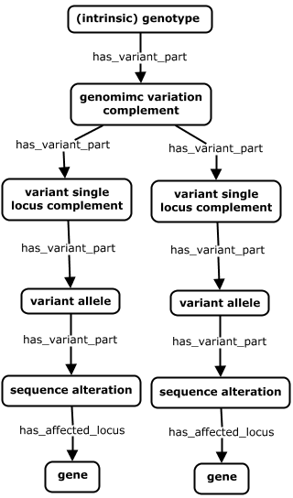
The Intrinsic Genotype Partonomy
An ‘intrinsic’ genotype is decomposed into its more fundamental components of variation that represent the ‘levels’ of variation to which phenotype are commonly associated.
Describes sequence variation across an entire genome in terms of its differences from some genomic background.
fgf8a^{ti282a / ti282a}; fgf3^{t24149 / +} (AB)
The variant portion of a genome, comprised of the set of all single locus complements containing at least one variant.
fgf8a^{ti282a / ti282a}; fgf3^{t24149 / +}
The set of all alleles at a single locus where at least one allele is variant
fgf8a^{ti282a / ti282a} | fgf3^{t24149 / +}
A continuous feature that contains as part a sequence alteration (or is itself a sequence alteration). Typically a variant version of a gene (i.e. a gene haplotype).
allele
allele
fgf8a^{ti282a} | fgf3^{t24149}
A continuous feature whose extent is the deviation from a reference. Typically a particular mutation within a gene.
ti282a | t29149
affected_feature
affected_feature
The gene(s) that are altered by a sequence alteration as part of the genotype.
fgf8a | fgf3
Notes:
(This example is pulled from the ZFIN record here: https://zfin.org/ZDB-FISH-150901-9362)
A Unified view of the full genotype partonomy, with definitions and examples for each level. https://zfin.org/ZDB-GENO-161227-1
* This cdkn1ca^{MO3-cdkn1ca} variant is a morpholino-targeted gene that is part of the extrinsic genotype. The breakdown in this figure shows only decomposition of the intrinsic genotype. Modeling of the extrinsic genotype is detailed in subsequent slides.
GENO models genotype ‘content’ with relatively precise granularity (i.e. explicit representation of distinct ‘levels’ of variation, and partonomic relationships between them) relative to other approaches. For example, Flybase treats genotypes merely as ‘bags of alleles’ – forgoing explicit representation of each level above. The GENO model is built this way to support two key use cases. The first is related to integration of G2P data across diverse systems and species – where phenotypes may be asserted at each of the levels of genetic variation described in the partonomy above. The second concerns the need to ‘propagate’ phenotypes up and/or down this partonomy – i.e. inferring associations between phenotypes and variant entities other than that where the phenotype as asserted to hang.

Slide 8
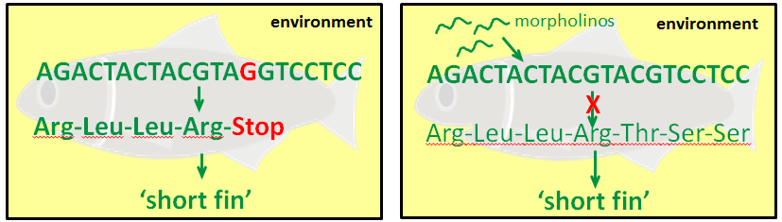
Intrinsic vs Extrinsic Genotypes
The concept of a ‘genotype’ in GENO is viewed broadly to apply to any variation in genomic sequence or variation in gene expression that is tied to an observed phenotypic effect. We distinguish three categories of genotypes:
Intrinsic genotypes describe variation in the genomic sequence (e.g. pt. mut, deletion., transgenic ins.).
Extrinsic genotypes describe variation in gene expression (resulting from gene targeting technologies such as RNAi, morpholinos).
Effective genotypes describe total variation in gene sequence or expression (intrinsic + extrinsic)
SEQUENCE-VARIATION
EXPRESSION-VARIATION
‘Intrinsic’ Genotype
‘Extrinsic’ Genotype
fgf8^{ti282a/ti282a}(AB)
+
shhb^{MO1-shhb}
‘Effective’ Genotype
fgf8^{ti282a/ti282a}(AB); shhb^{MO1-shhb}
Notes:
A unique aspect of GENO is that it views genotypes broadly to apply to any variation in gene expression that is tied to an observed phenotypic effect. Here we distinguish two types of variation.
The traditional view of genotypes describes inherent variation in genomic sequences. A simple example of such sequence variation is a point mutation that causes premature truncation of a protein, and might lead to a fish having a short fin. In GENO we refer to such genotypes as being ‘intrinsic’.
But there now exists an increasing number of molecular biology techniques for targeting gene expression using reagents such as morpholinos - where variation in gene expression can be induced at the time of an experiment without altering intrinsic genomic sequence. This expression-level-variation is the other major form of alteration that can be described using GENO. Here, targeting a WT version of this same gene with a morpholino can lead to the same phenotype of having a short fin. In GENO we describe such variation in an artifact called an ‘extrinsic’ genotype.
*** Key distinction is whether the alteration permanently changes or adds genomic sequence (intrinsic), vs transiently alters gene expression during the course of an experiment or observation (extrinsic) ***
*** Key similarity is that intrinsic and extrinsic variants are both represented as sequence features (or collections of features) – i.e. extents of biological sequence in a cell or organism that are variant in intrinsic/inherent feature (sequence or position) or extrinsic factors (expression resulting from external gene-specific intervention) ***
Effective genotypes then describe total variation in gene sequence or expression (intrinsic + extrinsic). This is analogous to the ZFIN idea of a FISH (though perhaps not entirely semantically equivalent)
------------------
These are structured and broken down in an analogous fashion as an intrinsic genotype. And syntactically, their representations are presented to users in a format that mirrors a traditional genotype – with targeting reagents being superscripted above gene names to indicate how each gene varies in its expression from WT.

Slide 9
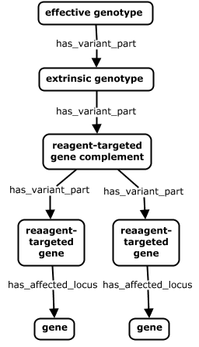
The Extrinsic Genotype Partonomy
An ‘extrinsic’ genotype is similarly decomposed into its more fundamental components of variation in gene expression.
Describes total variation in genomic sequence (intrinsic genotype) and gene expression (extrinsic genotype) across a genome.
mib1^{m178/m178} (AB); her9^{MO1-her9} ; her3^{MO3-her3}
The set of all genes in a cell or organism whose expression is transiently increased or decreased through gene-specific interventions in an experiment
her9^{MO1-her9} ; her3^{MO3-her3}
The set of all genes whose expression is targeted by gene-specific knockdown reagents in an experiment.
her9^{MO1-her9} ; her3^{MO3-her3}
A single gene whose expression is targeted by gene k.d. reagents in an experiment (her9^{MO1-her9} is an instance of the her9 gene that is variant in its expression, analogous to a her9^{sa43978} allele which is variant in its sequence.)
her9^{MO1-her9} | her3^{MO3-her3}
affected_feature
affected_feature
The gene(s) that are affected/altered in the extrinsic genotype.
her9 | her3
Notes:
(This example is pulled from the ZFIN record here: https://zfin.org/ZDB-FISH-150901-13364)
It is important to note here that the extrinsic variation classes here represent sequence features analogous to intrinsic forms of variation – i.e. they represent the extent of gene sequence in a genome that is ‘variant’ in terms of its expression in a given experimental setting.
So an effective genotype here really represents a collection of genomic sequence features in the context of a particular G2P experiment that are variant either in their sequence or expression level. This is the set of variant features that matter to biologists when assessing the causal elements behind a phenotype.
------------------
Identity of an instance of an extrinsic variant is sequence, position, AND experimental context (w.r.t. gene-specific interventions applied)
fgf8a^{ti282a / ti282a}; fgf3^{t24149}
chd^{MO1-chd} ; fsta^{MO6-fsta}

Slide 10
Summary
GENO provides a complete and connected model of genetic variation – providing explicit representation of each ‘level’ of variation, and defining the mereological relationships between them.
Intrinsic and extrinsic variants are both represented as sequence features (or collections of features) – i.e. extents of biological sequence in a cell or organism that are variant in their sequence or expression.
The GENO model is built this way to support two key use cases:
Integration of G2P data across diverse systems and species – where phenotypes may be asserted at each of the levels of genetic variation described in the partonomy above.
Parallel ‘propagation’ of phenotypes up and/or down partonomies of intrinsic or extrinsic genotypes

Slide 11
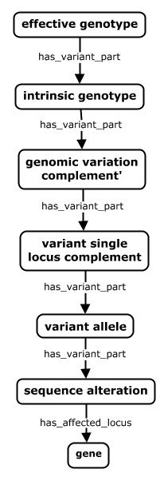
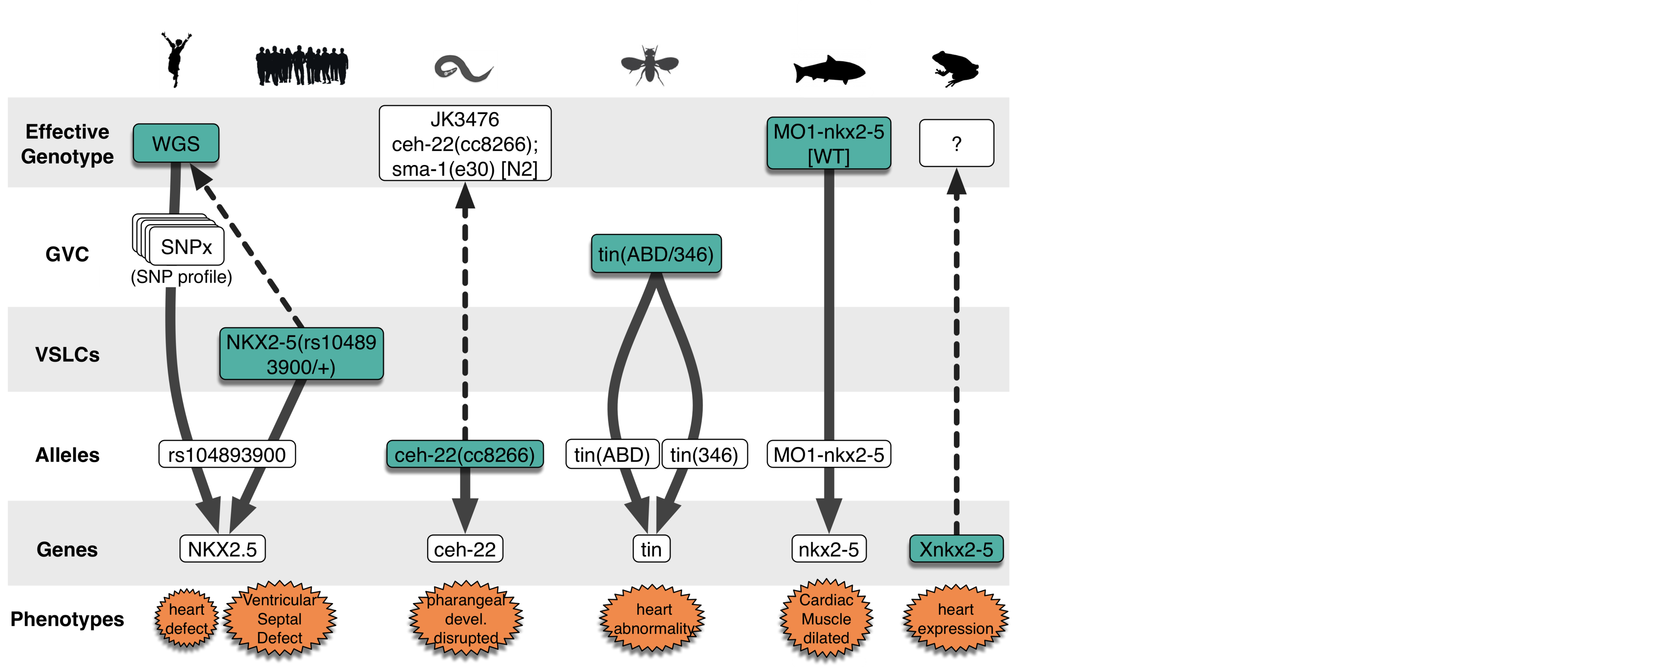
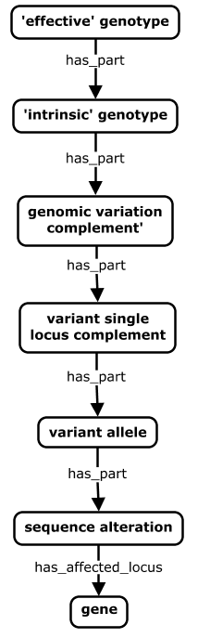

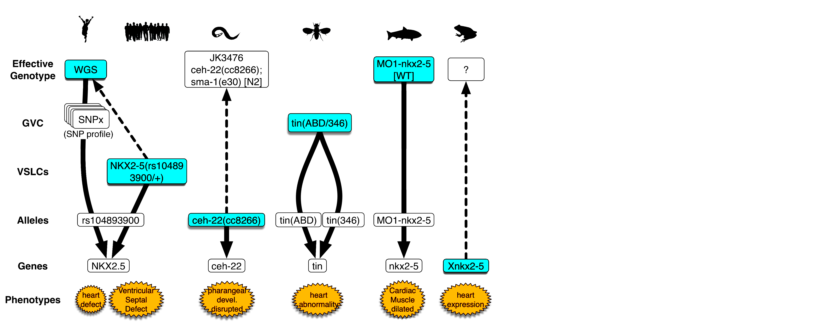

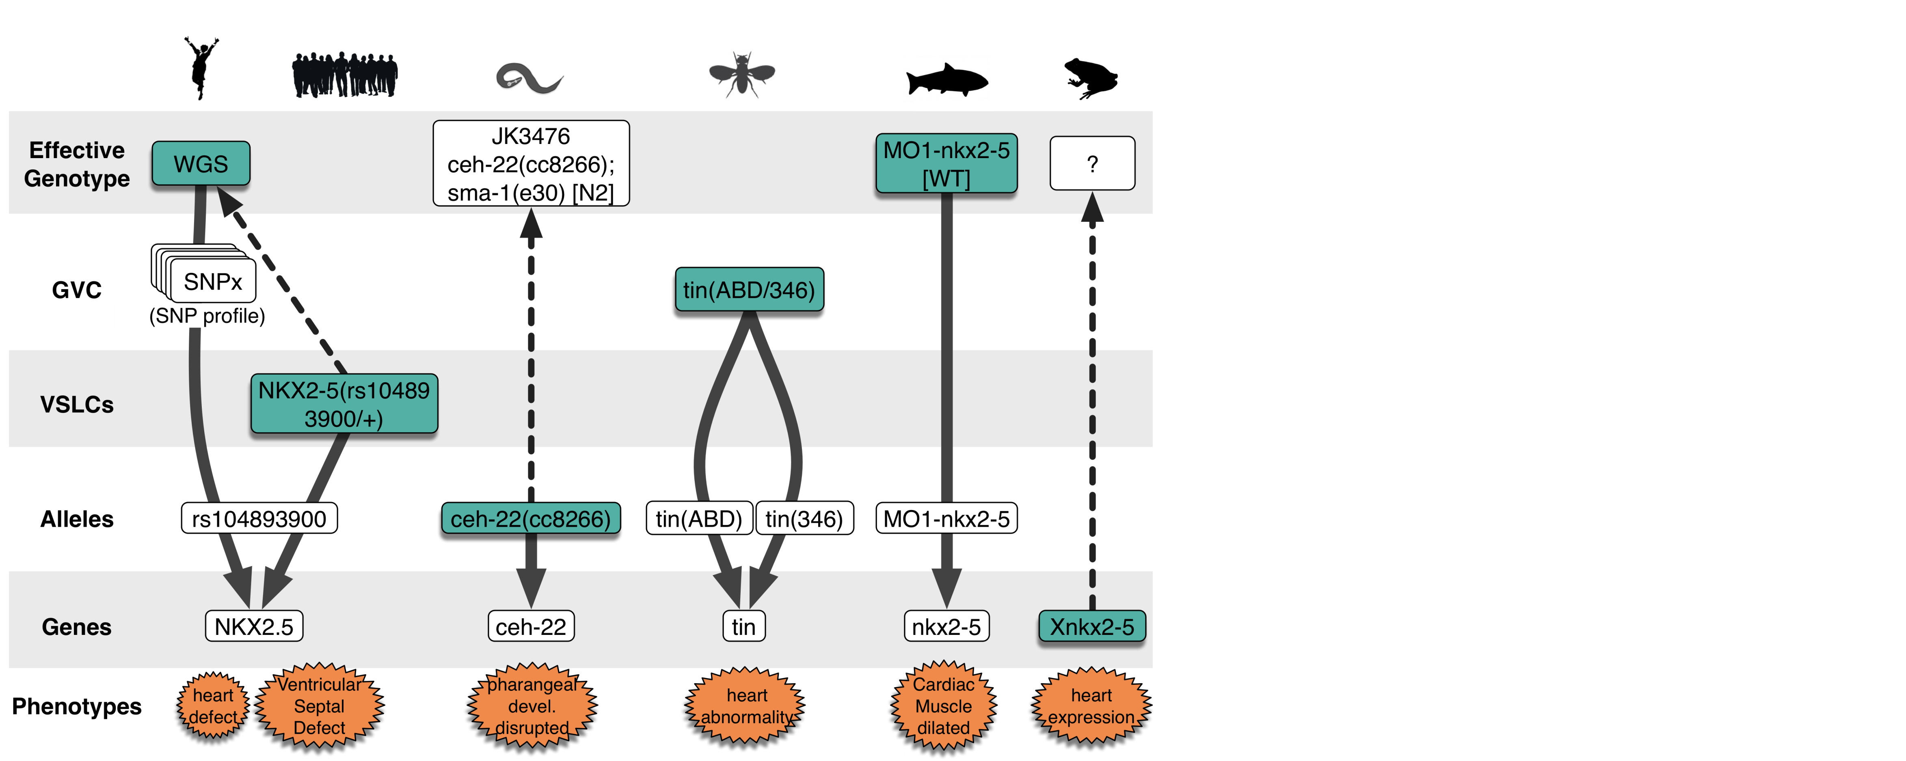
Use Case 1: Integration of Genotype Representations
Core genotype partonomy describes levels of variation at which phenotype annotations are made in different species/systems
fgf8a^{ti282a/ti282a};shha^{tbx392/+}[TL]; cdkn1ca^{MO3-cdkn1ca}
ZFIN
Mysm1<tm1a>/Mysm1<tm1a>[C57BL/6]
MGI,
IMPC
tin(ABD/346)
Flybase
daf-2(e1370)
Wormbase
ATP1A3(NM_152296.3)
[c.946G>A, p.Gly316Ser]
ClinVar

Slide 12
Use Case 1: Integration of Genotype Representations
Developing a GENO Data Model to support formal schema for data representation
To Do – add diagram and link to the developing GENO information model and example schemas/profiles.
Notes:
GENO is an ontology - a formal, computable model of the domain of assertions and the evidence and provenance supporting them.
ontologies are 'open world' models of a domain, but not schema. Ontologies define necessary and sufficient conditions for class membership, using the OWL description logic language
(i.e. they capture properties that all instances MUST have in reality - but don’t specify properties that they CAN have)
Monarch defines a formal information model for genotype representaiton using terms/constructs/design patterns defined in GENO – to support creation of formal, computable schema that can be used to constrain and validate data, and share with others who may want to adopt our modeling approaches.
Uses and is types and relationships defined in the ontology, and consistent with logic defined in the ontology. and will support creation of formal schema that add closed world constraints to specify how data must be structured using GENO based on application specific requirements (e.g. when creating an instance of class x, attributes 1, 2, 3 are required, 4, 5, 6 are optional). And will define data types for each attribute (e.g. string, data time, array/list, reference to another object in the data, of values from a value set)

Slide 13
Use Case 2: Phenotype Propagation
'Phenotype propagation' refers to the process of inferring associations between phenotypes and variant entities at other levels in a genotype that were not directly annotated.
GENO partonomy provides a scaffold for phenotype propagation, which can be implemented in various ways (e.g. property chains defined within the ontology, or algorithmic operations defined externally)
This propagation generates G2P associations at different levels of granularity, enabling integrated analysis across datasets where phenotype annotations are differentially asserted.
Notes:
( i.e. inferring associations between phenotypes and variant entities at other levels in a genotype that were not directly annotated)
Phenotype propagation supports ability to retrieve and compare phenotype associations at different levels of the model, across sources

Slide 14
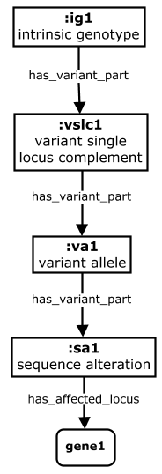
Phenotype Propagation ‘Down’ an Intrinsic Genotype
Property chains can be used to generate inferred phenotype associations to small parts of a genotype
has_phenotype
gut deformation
fgf8a^{ti282a/ti282a} [TL]
fgf8a^{ti282a/ti282a}
Property Chain
is_variant_part_of o
has_phenotype ->
has_phenotype
fgf8a^{ti282a}
ti282a
fgf8a
Notes:
Note that a phenotype propagation as shown above would be quite promiscuous – inferring G-P relationships where they might not truly exist. This is especially true for complex (multi-genic) genotypes such as the example above, where more than one gene locus is altered, and it is not clear which locus or loci is responsible for the phenotypes annotated to the complete genotype. Here, a conservative phenotype propagation approach would not infer G-P associations with the fgf8a variants or gene as shown.

Slide 15
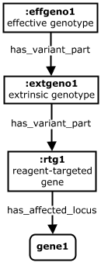
Phenotype Propagation ‘Down’ an Extrinsic Genotype
Because of their parallel design, the same rules can be used to generate inferred phenotype associations down extrinsic partonomies
has_phenotype
gut deformation
[AB] cdkn1ca^{MO3-cdkn1ca}
cdkn1ca^{MO3-cdkn1ca}
Property Chain
is_variant_part_of o
has_phenotype ->
has_phenotype
cdkn1ca^{MO3-cdkn1ca}
cdkn1ca

Slide 16
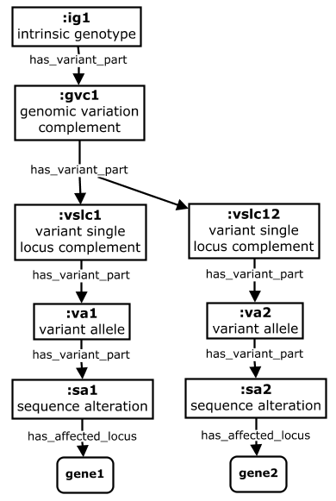
Phenotype Propagation Challenges
Propagation must be done with caution for ‘complex’ genotypes with multiple affected loci.
has_phenotype
gut deformation
fgf8a^{ti282a/ti282a};shha^{tbx392/+}[TL]
fgf8a^{ti282a/ti282a};shha^{tbx392/+}
Property Chain
*
is_variant_part_of o
has_phenotype ->
has_phenotype
fgf8a^{ti282a/ti282a} | shha^{tbx392/+}
fgf8a^{ti282a} | shha^{tbx392}
* Multi-gene genotypes:: Here it may not apparent which single gene is responsible for a given phenotype associated with the genotype
ti282a | tbx392
fgf8a | shha
Notes:
* Note that for complex / multigenic genotypes, it is typically not apparent which single variant/gene causes a given phenotype associated with the genotype. So phenotypes will in most cases not get propagated to separate variants/genes, unless there is corroborating evidence that they alone are causative for the phenotype. MGI’s work provides a nice example of how heuristic algorithms can be applied to determine when propagation to single variants/genes in the genotype is acceptable. See paper here: https://jbiomedsem.biomedcentral.com/articles/10.1186/s13326-016-0054-4.
----------------------
Note that at present, phenotype propagation as shown above is quite promiscuous – inferring G-P relationships where they might not truly exist. This is especially true for complex (multi-genic) genotypes such as the example above, where more than one gene locus is altered, and it is not clear which locus or loci is responsible for the phenotypes annotated to the complete genotype. Here, a conservative phenotype propagation approach would not infer G-P associations with the fgf8a variants or gene as shown.

Slide 17
Phenotype Propagation Challenges
Propagation must be done with caution for ‘complex’ genotypes with multiple affected loci.
has_phenotype
gut deformation
Df(Chr2:mib1,foxc1a)nn2002/+ [TL]
Property Chain
Df(Chr2:mib1,foxc1a)nn200/+
is_variant_part_of o
has_phenotype ->
has_phenotype
Df(Chr2:mib1,foxc1a)nn200
* Alts hitting >1 gene:
The sequence alteration here affects multiple genes, such that it is not clear which is responsible for the phenotype
Df(Chr2:mib1,foxc1a)nn200
*
cables1, cldn1, dvl3a, foxc1a, gata6, mib1, rab18b, selt1a, yme1l1b, znfl2a
genes
Notes:
Another case is large deficiencies/deletions that may me asserted to affect multiple genes – Care should be taken not to propagate phenotypes to all genes affected (unless there is additional evidence implicating one in particular)

Slide 18
Evolving Phenotype Propagation Approaches
More nuanced and precise algorithms needed to ensure maximal, accurate propagations can be assigned
MGI algorithm (Bello et al 2016)
more sophisticated gene annotation derivation algorithm
MGI added new allele metadata to support this approach
MGI rules align well with Monarch needs for ‘phenotype propagation’
Extensions for Monarch use case:
propagate phenotypes to other genotype components
consider additional factors/heuristics (e.g. leverage what we know about phenotypes associated with single gene genotypes - in same or different organisms?)
use probabilistic approaches (weighted inferences rather than binary)
Implementation approaches:
programmatic , cypher, OWL reasoning (property chains, SWRL rules)
Notes:
Probabilistic phenotype propagation
pp_{genex} = 1 / (# affected genes)
update pp based on additional factors
type of secondary mutations (e.g. inert reporters or recombinases)
known phenotypes for corresponding single gene genotypes

Slide 19
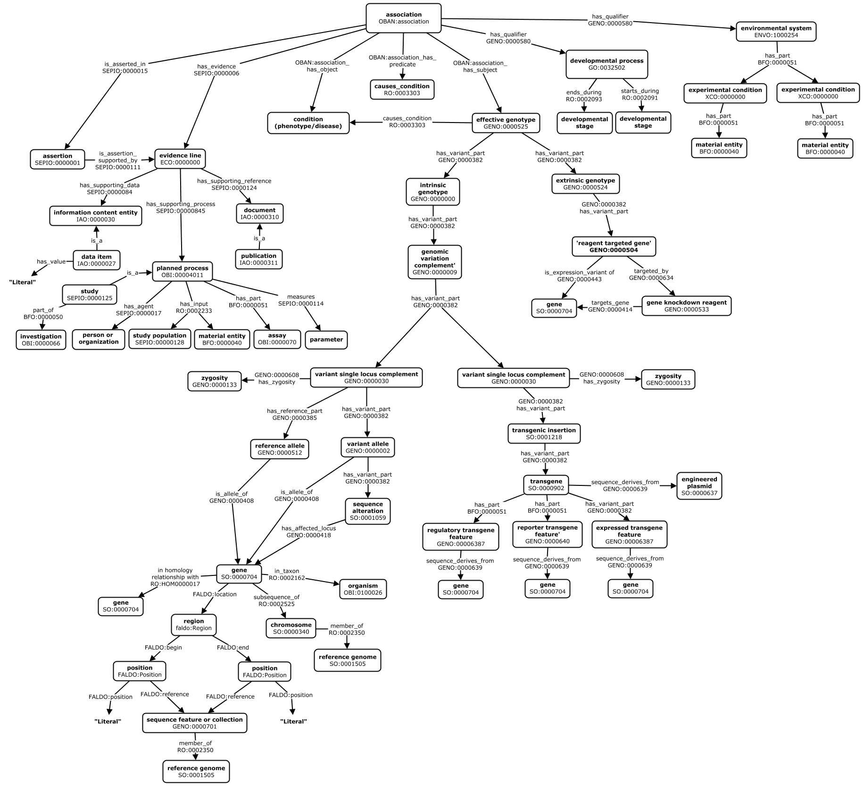
GENO Design Patterns
Association
Model
Developmental Stage
Environment
Evidence
Extrinsic
Genotype
Some of the details of the modeling here are outdated, but high level view of domains is accurate. Updated complete global model diagrams here.
Intrinsic
Genotype
Transgenes
Genes
GENO also supports representation of G2P association data, providing terms and design patterns to support standardized modeling of data from diverse sources.
Genomic
Position
Notes:
The core genotype partonomy is complemented by additional content that supports complete description of G2P associations..
Shown here is an abstract view of the design patterns it supports in modeling data ingested as rdf into the Monarch ‘SciGraph’ database.
Above is a 30000 ft view to give a sense of coverage – shown here colored according to different topics or ‘motifs’.
At core are the intrinsic and extrinsic genotype partonomies (green) representing the elements of genetic variation to which phenotypes and diseases are annotated.
The remaining patterns represent the association itself which is modeled according to the OBAN reification model (blue), its contextualizing environment (purple) and developmental stage (brown) information, evidence and provenance related metadata for the association (orange), and metadata about the genes affected in the genotype (red)

Slide 20
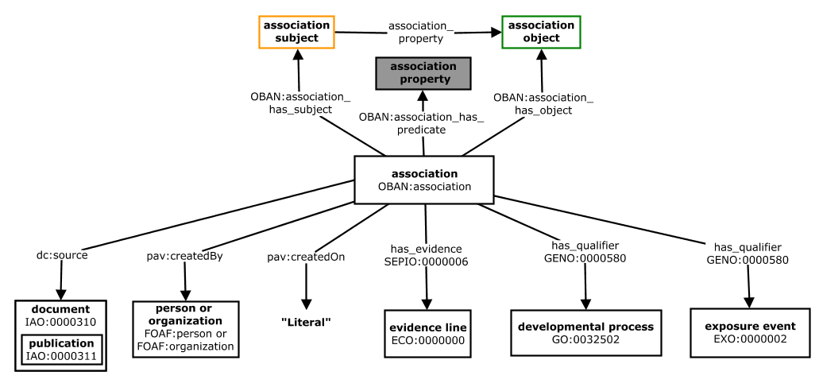
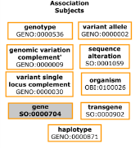
Association Model
Association subject for G2P associations = gene, genotype, or genotype part
Association object for G2P associations = phenotype or disease
Association property for G2P associations = has_phenotype (but moving to use of more expressive properties here)
Notes:
Based on OBAN model, extend with qualifiers for n-ary relationships.
Unclear if associations are ‘proposition’ or ‘assertion’ level entities (propositions being more abstract – with identity tied only to meaning of statement or fact, and assertions having their identity tied to provenance of their assertion – who said it, when, using what evidence, etc).

Slide 21
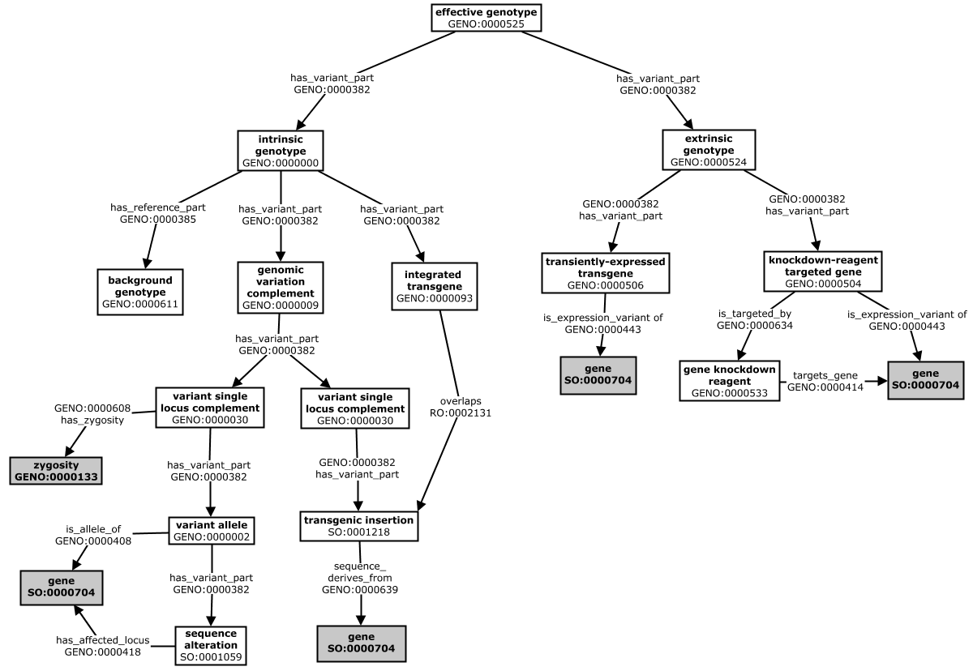
Intrinsic and Extrinsic Genotype Partonomies
*
Notes:
-----
WE WANT TO HANG ALL FEATURES RELEVANT TO INTRINSIC GENO FROM THE TG INSERTION – BECAUSE THIS IS THE SA.
AND JUSTIFIES HANGING THE TG DIRECTLY FROM THE GENOTYPE – AS AN ENTITY SEPARATE FROM THE INTRINSIC GENE PARTONOMY (WHICH IS CAPTURED IN THE TG INSERTION), BUT STILL PART OF THE INTRINSIC GENOTYPE

Slide 22
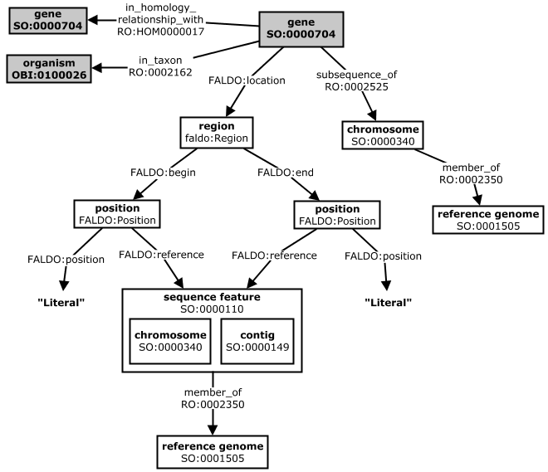
Gene Descriptions

Slide 23
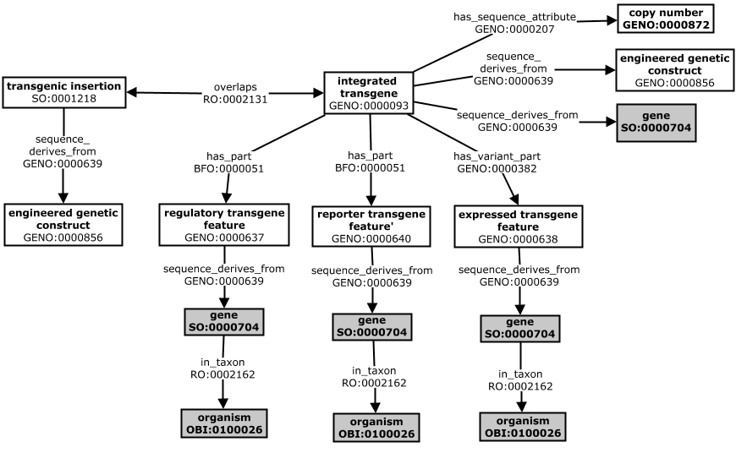
Transgene Descriptions
Notes:
Note that we are refining our representation of transgenes – an ongoing area of work in collaboration with other model organism databases.

Slide 24
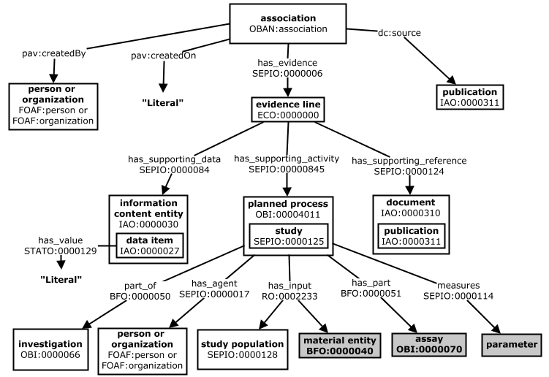
Evidence and Provenance

Slide 25
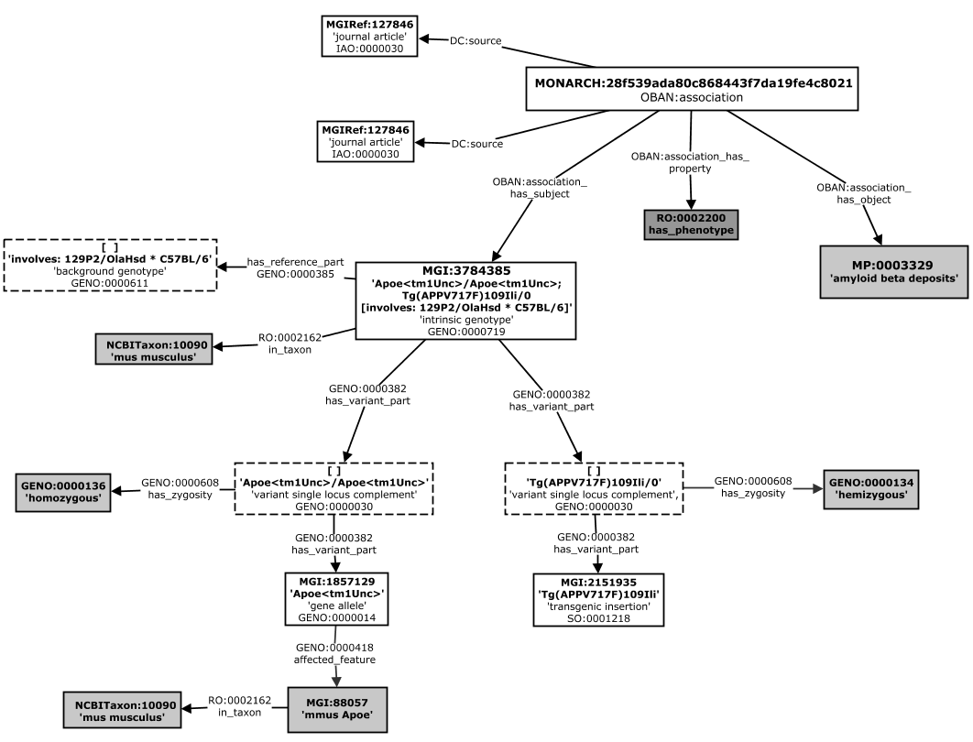
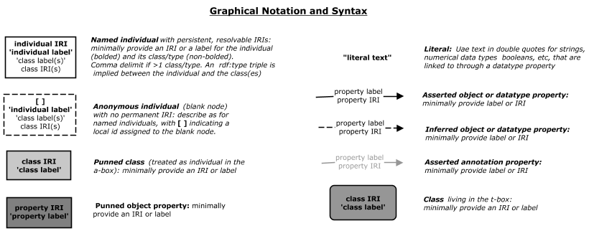
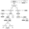
Data Example: MGI
http://www.informatics.jax.org/accession/MGI:3784385
Larger .jpg version of the diagram is here.
Notes:
GENO-AGR-MGI Profile Representation of a Complex Intrinsic Genotype (one affected gene and one randomly integrated transgene)
An RDF representation of an MGI genotype, using the GENO profile designed to capture the information specified in the AGR genotype schema (as of 6-8-18).
This profile represents the genotype, VSLC, and Allele levels of the genotype partonomy, as well as gene(s) affected by alleels in the genotype, and the genomic location of these genes.
The genotype in this example is comprised of a homozygous mutation in the Apoe gene and a randomly integrated transgene (Tg(APPV717F)109Ili).
See record at http://www.informatics.jax.org/accession/MGI:3784385.

Slide 26
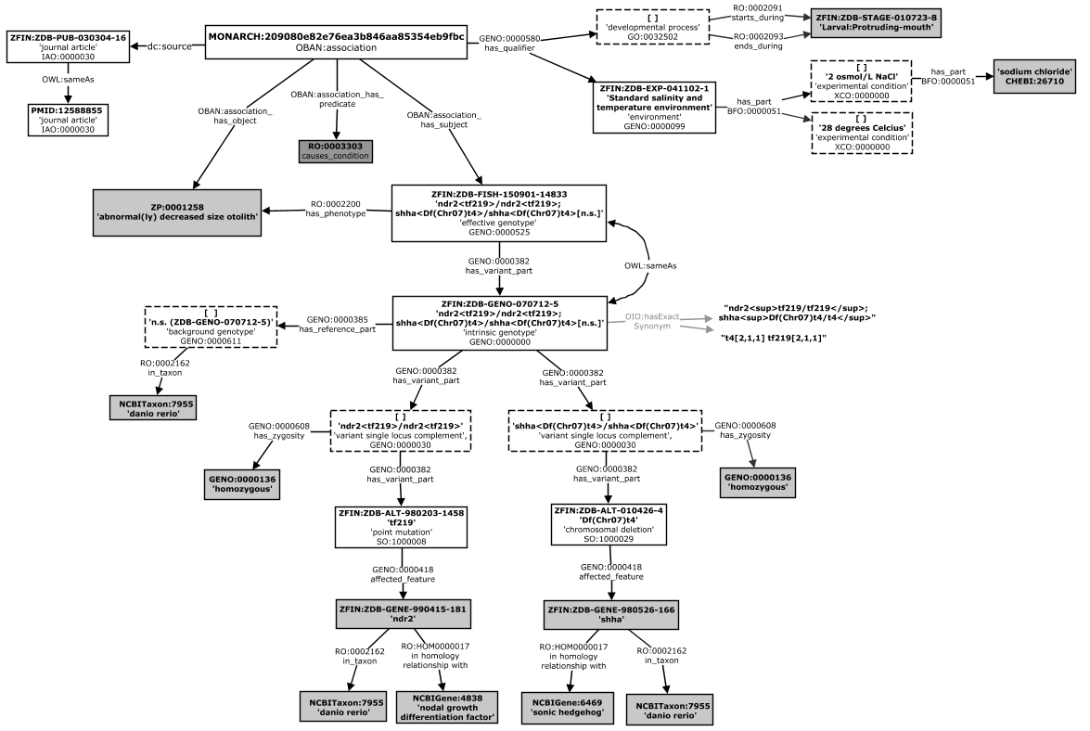
Data Example: ZFIN
https://zfin.org/ZDB-GENO-070712-5
Larger .jpg version of the diagram is here.
Notes:
Simplified model, omitting ‘levels’ without identifiers in ZFIN source.

Slide 27
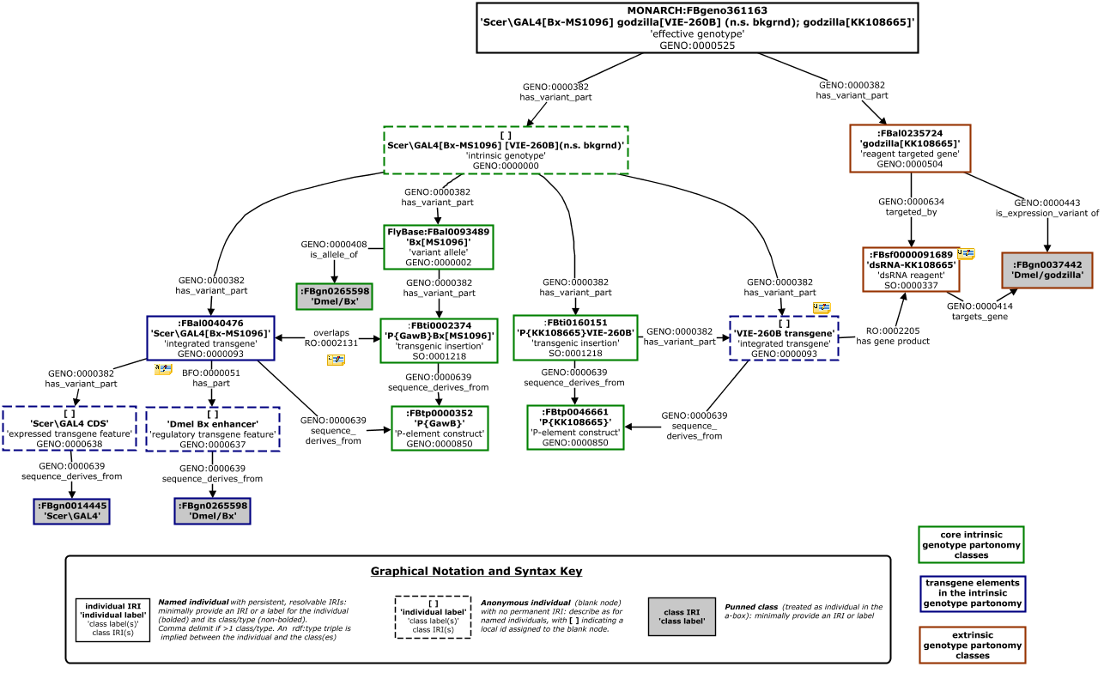
Data Example: Flybase
Links to source records for this example are provided in the doc at http://bit.ly/2D9b0nt
,
Jpg version of this cmap is here.
Notes:
This is a particularly complex genotype. The genotype and its modeling are discussed in detail here, but the GENO model above is not yet final or implemented in Monarch.

Slide 28
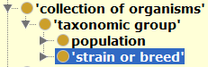
Key Concepts
Strain: A maximal collection of organisms of a single species that have been bred or experimentally manipulated with the goal of being genetically identical. Two mice with the same genotype information, but maintained in different labs, are different strains (many examples of this in MGI/IMSR)
Effective genotype: Describes the total variation in both genomic sequence along with all genes whose expression is transiently increased or decreased through gene-specific interventions in an experiment
(Intrinsic) Genotype: describes sequence variation across an entire genome, in terms of its differences from some genomic background.
Gene: A genomic region that contains of all sequence elements that facilitate the production of a functional transcript. A gene may include regulatory regions, transcribed regions and/or other functional sequence regions. (from SO).
Variant Allele: An sequence variant of a defined genetic locus that contains as part some sequence alteration, or is itself a sequence alteration.
Variant Gene Allele: An allele of a gene (i.e. a gene sequence that contains as part some sequence alteration)
Notes:
Gene locus (Gene allele): A genomic feature that is defined positionally, as the sequence present where a gene resides in some reference genome (ie the extent of genomic sequence that corresponds to the location of functional gene in some reference genome).

Slide 29
Key Concepts
(Integrated) Transgene: A gene that has been transferred naturally or by any of a number of genetic engineering techniques into a cell or organism where it is foreign (i.e. exogenous/extraneous to the host genome). ‘Integrated’ transgenes are those that are inserted into the host genome.
Transgenes can exist as integrated into the host genome, or extra-chromosomally on replicons or transiently carried/expressed vectors. What matters is that they are active in the context of a foreign biological system (typically a cell or organism).
Note that transgenes as defined here are not necessarily from a different taxon than that of the host genome. For example, a Mus musculus gene over-expressed from a chromosomally-integrated expression construct in a Mus musculus genome qualifies as a transgene because it is exogenous to the endogenous host genome.
Engineered genetic construct: An engineered region (sensu SO) that is used to transfer foreign genetic material into a host cell. Constructs can be engineered to carry inserts of DNA from external sources, for purposes of cloning and propagation or gene expression in host cells. Constructs are typically packaged as part of delivery systems such as plasmids or viral vectors

Slide 31
Extra/Outdated Slides

Slide 32
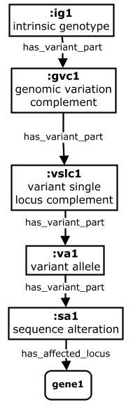

Phenotype Propagation ‘Up’ an Intrinsic Genotype
Phenotypes can be propagated ‘up’ a genotype as well, when annotations are made to smaller elements (e.g. alleles)
Property Chains
Down: is_variant_part_of o has_phenotype ->
has_phenotype
Up: has_variant_part o
has_phenotype ->
has_phenotype
daf-2(e1370) III; fog-2(oz40) V [n2]
daf-2(e1370) III; fog-2(oz40)V
*
daf-2(e1370)III
has_phenotype
gut deformation
daf-2(e1370)
e1370
daf-2
* Propagation up a genotype is not yet performed, as all sources assert phenotype associations on the highest level of the genotype they represent in their data. So propagation up a genotype would only happen if a separate source for the same species asserts phenotypes at a different level, where there may be an assertion on a variant allele from Source A that could get propagated to a complete genotype containing this variant in Source B. But as noted later for propagation ‘down’ genotypes, we may not want to propagate to complex genotypes where more than one gene is affected.
Notes:
-------------
An example of propagation ‘up’ (and ‘down’) a genotype – for a wormbase G-P annotation made at the level of the variant allele.
This is rarer, because usually pheno annotations in a source are made at the highest level captured. So propagation ‘up’ would only happen if data is integrated with another source 2 that describes genotype components at a higher-level than that annotated in source 1.
* As with propagation down from complex / multigenic genotypes, caution must be taken to consider genetic interactions when propagating up to complex genotypes that contain variants in addition to the annotated allele.

Slide 33
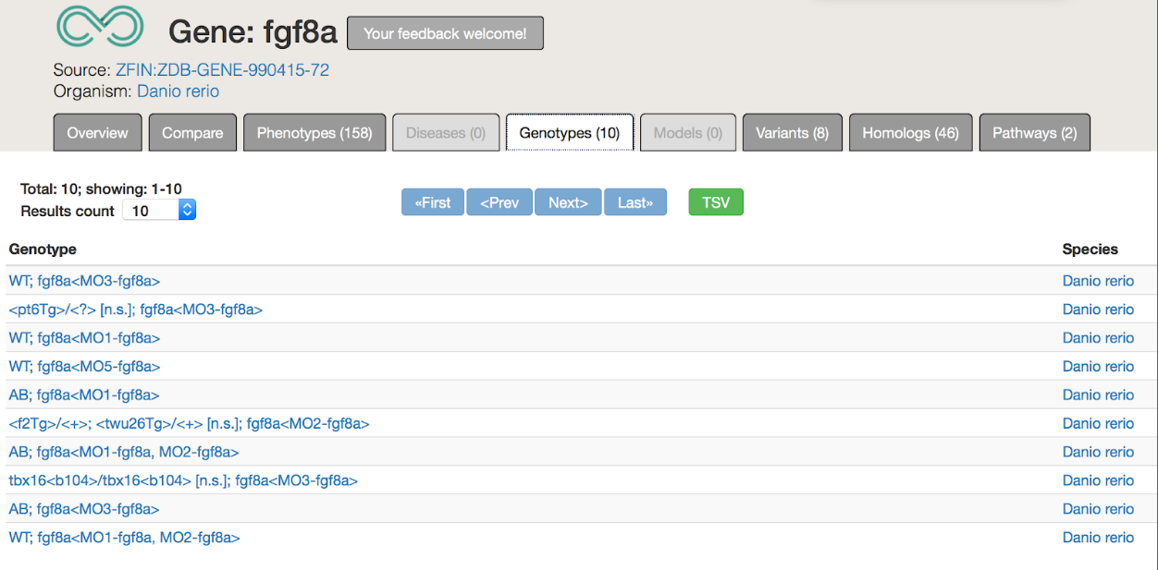

Slide 34
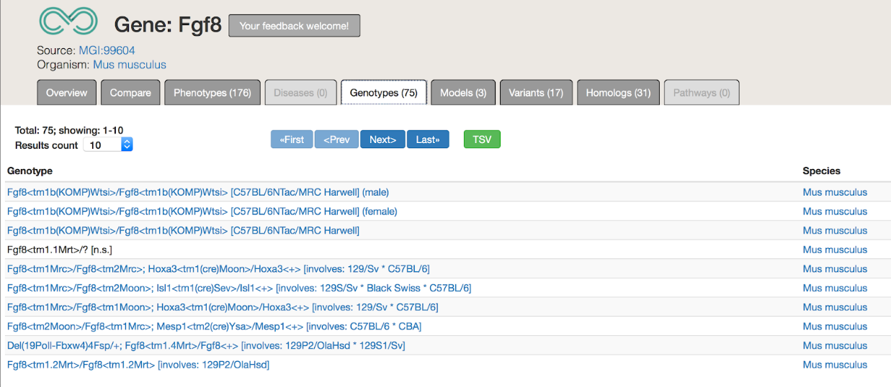

Slide 35
Challenges/Approaches
Challenges
Each MOD has a different datamodel for genotypes and genetic entities
Each MOD has different curation practices for which kind of entity they attach phenotypes to
Approach
Hierarchical ‘partonomy’ model of genotypes
Analogy with genomic entities
Gene, transcript, feature
GFF3, SO
GENO: Genotype Ontology
https://github.com/monarch-initiative/GENO-ontology

Slide 36
The Intrinsic Genotype Partonomy
An ‘intrinsic’ genotype is decomposed into its more fundamental components of variation that represent the ‘levels’ of variation to which phenotype are commonly associated.
Describes sequence variation across an entire genome in terms of its differences from some genomic background.
fgf8a^{ti282a / ti282a}; fgf3^{t24149 / +} (AB)
The variant portion of a genome, comprised of the set of all single locus complements containing at least one variant.
fgf8a^{ti282a / ti282a}; fgf3^{t24149 / +}
The set of all alleles at a single locus where at least one allele is variant
fgf8a^{ti282a / ti282a} | fgf3^{t24149 / +}
A continuous feature that contains as part a sequence alteration (or is itself a sequence alteration). Typically a variant version of a gene (i.e. a gene haplotype).
gene
gene
fgf8a^{ti282a} | fgf3^{t24149}
A continuous feature whose extent is the deviation from a reference. Typically a particular mutation within a gene.
ti282a | t29149
affected_feature
affected_feature
The gene(s) that are altered by a sequence alteration as part of the genotype.
fgf8a | fgf3
Notes:
(This example is pulled from the ZFIN record here: https://zfin.org/ZDB-FISH-150901-9362)
A Unified view of the full genotype partonomy, with definitions and examples for each level. https://zfin.org/ZDB-GENO-161227-1
* This cdkn1ca^{MO3-cdkn1ca} variant is a morpholino-targeted gene that is part of the extrinsic genotype. The breakdown in this figure shows only decomposition of the intrinsic genotype. Modeling of the extrinsic genotype is detailed in subsequent slides.
GENO models genotype ‘content’ with relatively precise granularity (i.e. explicit representation of distinct ‘levels’ of variation, and partonomic relationships between them) relative to other approaches. For example, Flybase treats genotypes merely as ‘bags of alleles’ – forgoing explicit representation of each level above. The GENO model is built this way to support two key use cases. The first is related to integration of G2P data across diverse systems and species – where phenotypes may be asserted at each of the levels of genetic variation described in the partonomy above. The second concerns the need to ‘propagate’ phenotypes up and/or down this partonomy – i.e. inferring associations between phenotypes and variant entities other than that where the phenotype as asserted to hang.

Slide 37
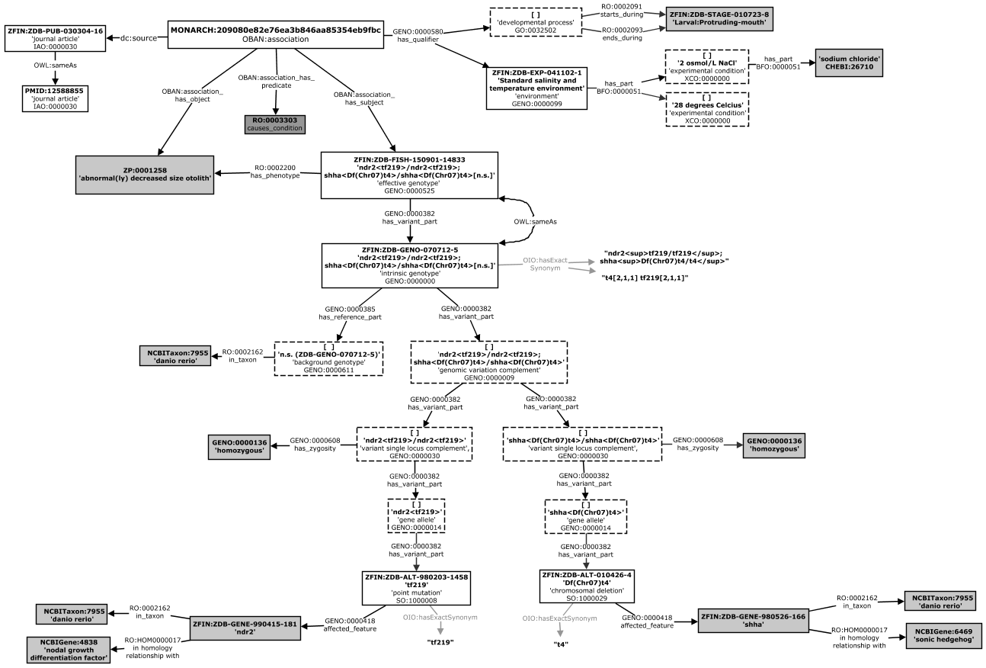
Data Example: ZFIN
https://zfin.org/ZDB-GENO-070712-5

